Slide 1

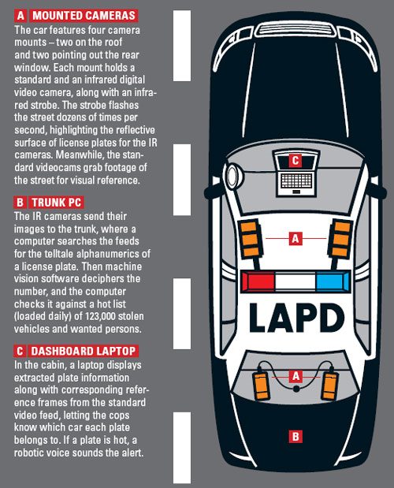
Interesting article in the March, 2006 issue of Wired magazine
Read it here
Notes:
《连线》杂志
LAPD：洛杉矶警察局
Dashboard :汽车仪表盘
Trunk：后备箱
Laptop:轻便电脑
Strobe：闪光灯
IR： 红外
Footage：连续镜头
Telltale:报警的
decipher：解读
Cabin:驾驶舱

Slide 2
Digital Image Processing
Image Enhancement
图像增强
(Spatial Filtering 1)
空间滤波1

Slide 3
Contents
In this lecture we will look at spatial filtering techniques:
  Neighbourhood operations
  What is spatial filtering?
  Smoothing operations
  What happens at the edges?
  Correlation（相关） and convolution（卷积）

Slide 4
Neighbourhood Operations
邻域操作
Neighbourhood operations simply operate on a larger neighbourhood of pixels than point operations
Neighbourhoods are
mostly a rectangle
around a central pixel
Any size rectangle
and any shape filter
are possible
Origin
x
(x, y)
Neighbourhood
y
Image f (x, y)

Slide 5
Simple Neighbourhood Operations
简单的邻域操作
Some simple neighbourhood operations include:
  Min(最小值): Set the pixel value to the minimum in the neighbourhood
  Max（最大值）: Set the pixel value to the maximum in the neighbourhood
  Median（中值）: The median value of a set of numbers is the midpoint value in that set (e.g. from the set [1, 7, 15, 18, 24] 15 is the median). Sometimes the median works better than the average

Slide 6
Simple Neighbourhood Operations Example
Original Image
x
Enhanced Image
x
123
127
128
119
115
130
140
145
148
153
167
172
133
154
183
192
194
191
194
199
207
210
198
195
164
170
175
162
173
151
y
y

Slide 7
The Spatial Filtering Process
空间滤波处理
Origin
x
a
b
c
r
s
t
d
e
f
*
u
v
w
g
h
i
x
y
z
Original Image Pixels
Filter
Simple 3*3
Neighbourhood
e
3*3 Filter
e_{processed} = v*e +
r*a + s*b + t*c +
u*d + w*f +
x*g + y*h + z*i
y
Image f (x, y)
The above is repeated for every pixel in the original image to generate the filtered image

Slide 8
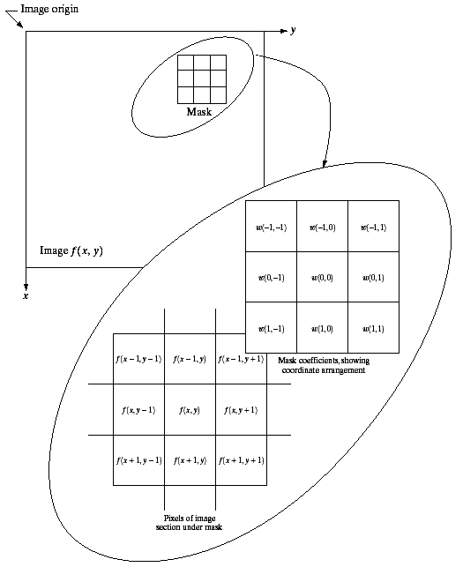
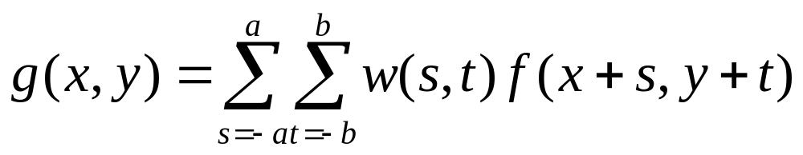

Spatial Filtering: Equation Form
Filtering can be given in equation form as shown above
Notations（符号） are based on the image shown to the left
Images taken from Gonzalez & Woods, Digital Image Processing (2002)

Slide 9
Smoothing Spatial Filters
平滑空间滤波器
One of the simplest spatial filtering operations we can perform is a smoothing operation
  Simply average all of the pixels in a neighbourhood around a central value
  Especially useful
  in removing noise
  from images
  Also useful for
  highlighting gross
  detail
¹/₉ | ¹/₉ | ¹/₉
¹/₉ | ¹/₉ | ¹/₉
¹/₉ | ¹/₉ | ¹/₉
Simple averaging filter
Notes:
去除噪声，去除不相干的细节

Slide 10
Smoothing Spatial Filtering
Origin
x
104
100
108
¹/₉
¹/₉
¹/₉
99
106
98
*
¹/₉
¹/₉
¹/₉
95
90
85
¹/₉
¹/₉
¹/₉
Original Image Pixels
Filter
¹/₉
¹/₉
¹/₉
Simple 3*3
Neighbourhood
104
100
108
3*3 Smoothing
Filter
¹/₉
¹/₉
¹/₉
99
106
98
¹/₉
¹/₉
¹/₉
95
90
85
e = ¹/₉*106 +
¹/₉*104 + ¹/₉*100 + ¹/₉*108 +
¹/₉*99 + ¹/₉*98 +
¹/₉*95 + ¹/₉*90 + ¹/₉*85
= 98.3333
y
Image f (x, y)
The above is repeated for every pixel in the original image to generate the smoothed image

Slide 11
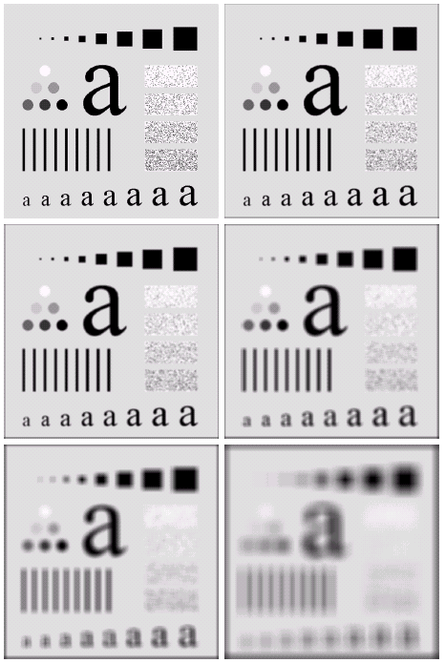
Image Smoothing Example
The image at the top left
is an original image of
size 500*500 pixels
The subsequent images
show the image after
filtering with an averaging
filter of increasing sizes
  3, 5, 9, 15 and 35
Notice how detail begins
to disappear
Images taken from Gonzalez & Woods, Digital Image Processing (2002)

Slide 12
Image Smoothing Example
Images taken from Gonzalez & Woods, Digital Image Processing (2002)

Slide 13
Image Smoothing Example
Images taken from Gonzalez & Woods, Digital Image Processing (2002)

Slide 14
Image Smoothing Example
Images taken from Gonzalez & Woods, Digital Image Processing (2002)

Slide 15
Image Smoothing Example
Images taken from Gonzalez & Woods, Digital Image Processing (2002)

Slide 16
Image Smoothing Example
Images taken from Gonzalez & Woods, Digital Image Processing (2002)

Slide 17
Image Smoothing Example
Images taken from Gonzalez & Woods, Digital Image Processing (2002)

Slide 18
Weighted Smoothing Filters
加权平滑滤波器
More effective smoothing filters can be generated by allowing different pixels in the neighbourhood different weights in the averaging function
  Pixels closer to the
  central pixel are more
  important
  Often referred to as a
  weighted averaging
¹/₁₆ | ²/₁₆ | ¹/₁₆
²/₁₆ | ⁴/₁₆ | ²/₁₆
¹/₁₆ | ²/₁₆ | ¹/₁₆
Weighted averaging filter

Slide 19
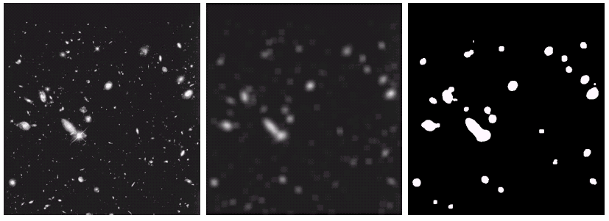
Another Smoothing Example
By smoothing the original image we get rid of lots of the finer detail which leaves only the gross features for thresholding
Images taken from Gonzalez & Woods, Digital Image Processing (2002)
Original Image
Smoothed Image
Thresholded Image

Slide 20

Averaging Filter Vs. Median Filter Example
Original Image
With Noise
Image After
Averaging Filter
Image After
Median Filter
Images taken from Gonzalez & Woods, Digital Image Processing (2002)
Filtering is often used to remove noise from images
Sometimes a median filter works better than an averaging filter

Slide 21
Averaging Filter Vs. Median Filter Example
Images taken from Gonzalez & Woods, Digital Image Processing (2002)

Slide 22
Averaging Filter Vs. Median Filter Example
Images taken from Gonzalez & Woods, Digital Image Processing (2002)

Slide 23
Averaging Filter Vs. Median Filter Example
Images taken from Gonzalez & Woods, Digital Image Processing (2002)

Slide 24
Simple Neighbourhood Operations Example
x
123
127
128
119
115
130
140
145
148
153
167
172
133
154
183
192
194
191
194
199
207
210
198
195
164
170
175
162
173
151
y

Slide 25
Strange Things Happen At The Edges!
At the edges of an image we are missing pixels to form a neighbourhood
Origin
x
e
e
e
e
e
e
e
y
Image f (x, y)

Slide 26
Strange Things Happen At The Edges! (cont…)
There are a few approaches to dealing with missing edge pixels:
  Omit missing pixels
    Only works with some filters
    Can add extra code and slow down processing
  Pad the image
    Typically with either all white or all black pixels
  Replicate border pixels
  Truncate the image
  Allow pixels wrap around the image
    Can cause some strange image artefacts

Slide 27
Simple Neighbourhood Operations Example
x
123
127
128
119
115
130
140
145
148
153
167
172
133
154
183
192
194
191
194
199
207
210
198
195
164
170
175
162
173
151
y

Slide 28
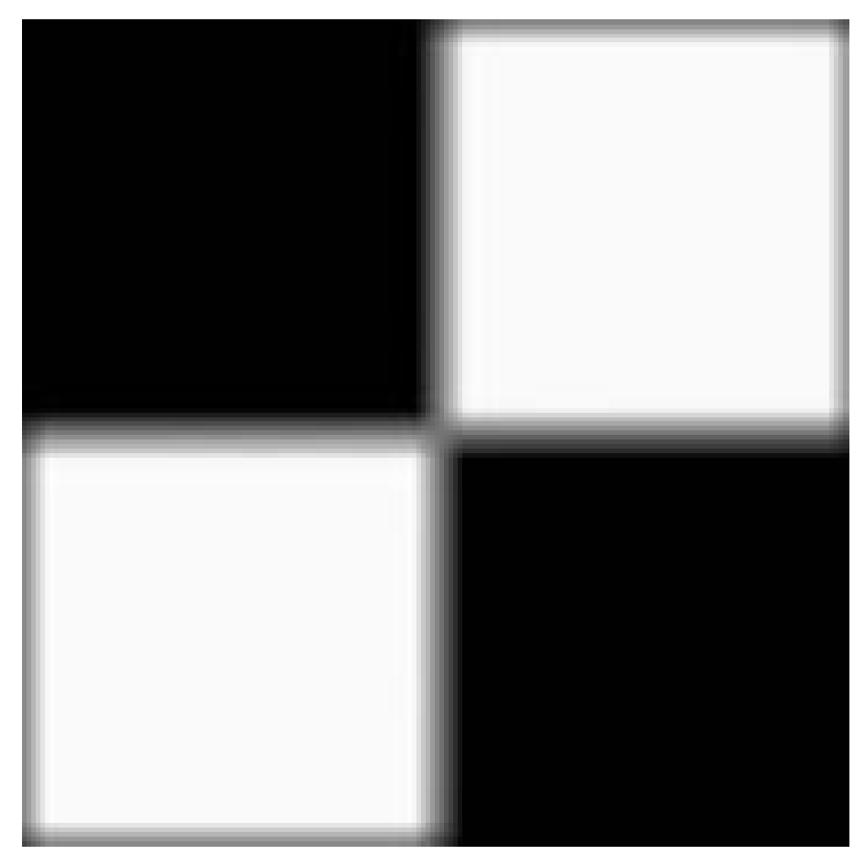


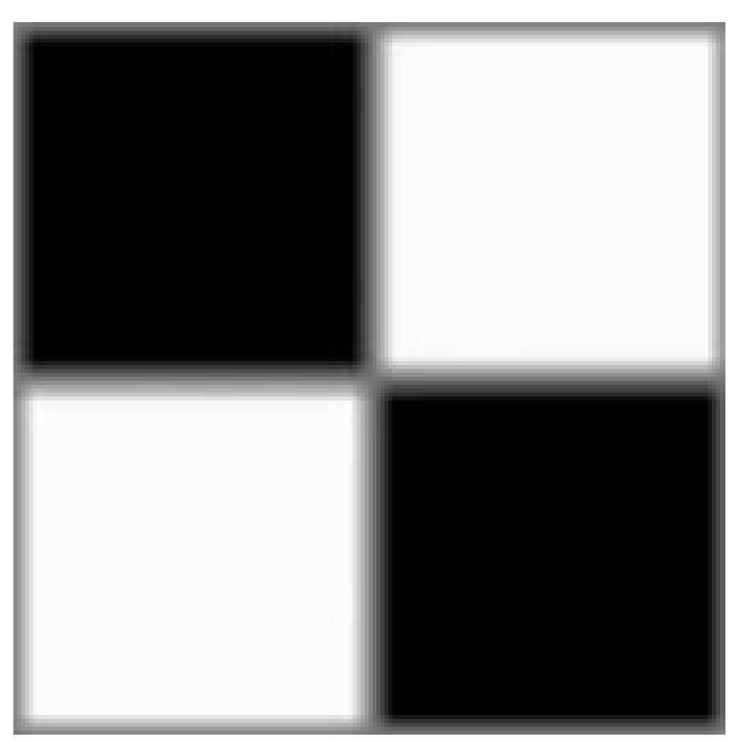
Strange Things Happen At The Edges! (cont…)
Filtered Image: Zero Padding
Original
Image
Filtered Image: Replicate Edge Pixels
Images taken from Gonzalez & Woods, Digital Image Processing (2002)
Filtered Image:
Wrap Around Edge Pixels

Slide 29
Strange Things Happen At The Edges! (cont…)
Images taken from Gonzalez & Woods, Digital Image Processing (2002)

Slide 30
Strange Things Happen At The Edges! (cont…)
Images taken from Gonzalez & Woods, Digital Image Processing (2002)

Slide 31
Strange Things Happen At The Edges! (cont…)
Images taken from Gonzalez & Woods, Digital Image Processing (2002)

Slide 32
Correlation & Convolution
相关&卷积
The filtering we have been talking about so far is referred to as correlation with the filter itself referred to as the correlation kernel
Convolution is a similar operation, with just one subtle difference
For symmetric filters it makes no difference
a
b
c
r
s
t
e_{processed} = v*e +
z*a + y*b + x*c +
w*d + u*e +
t*f + s*g + r*h
d
e
e
*
u
v
w
f
g
h
x
y
z
Original Image Pixels
Filter

Slide 33
Summary
In this lecture we have looked at the idea of spatial filtering and in particular:
  Neighbourhood operations
  The filtering process
  Smoothing filters
  Dealing with problems at image edges when using filtering
  Correlation and convolution
Next time we will looking at sharpening filters and more on filtering and image enhancement

